Slide 1


transaction management system
~ Param jani
19dcs042

Slide 2
Project definition
The transaction management system is an application for maintaining a person’s account in a bank.
The system provides the access to the customer to create an account, deposit/withdraw the money from his account, also to view reports of all accounts present.
The following presentation provides the specification for the system.

Slide 3
Description
The Transaction Management System is a software created to improve a customer’s banking experience.
It nurtures the needs of an end banking user by providing a better way to perform banking tasks.
An efficient interface has been developed to make management easy and quick, which is not possible with the manual systems.
The software gives the user complete access and control to their account.

Slide 4
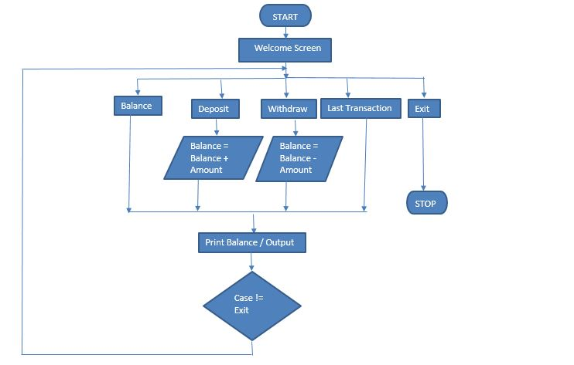
Flowchart

Slide 5
System requirements
Software:
Windows 7 onwards (small display screen, no graphic card requirement)
Minimum 256 MB
Minimum 10 MB of space
Latest version of Python
Anaconda - Jupyter Notebook
Hardware:
Core i3 Processor
RAM 2 GB
HDD Capacity 500GB

Slide 6
Limitations
Technology and Service Interruptions
Security and Identity Theft Concerns
Limitations on Deposits
Convenient but Not Always Faster
Lack of Personal Banker Relationship
A Limited Scope of Services

Slide 7
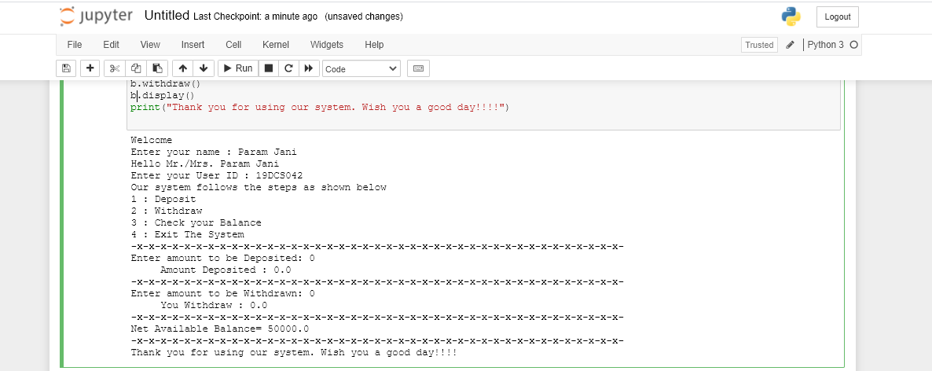
output of balance check

Slide 8
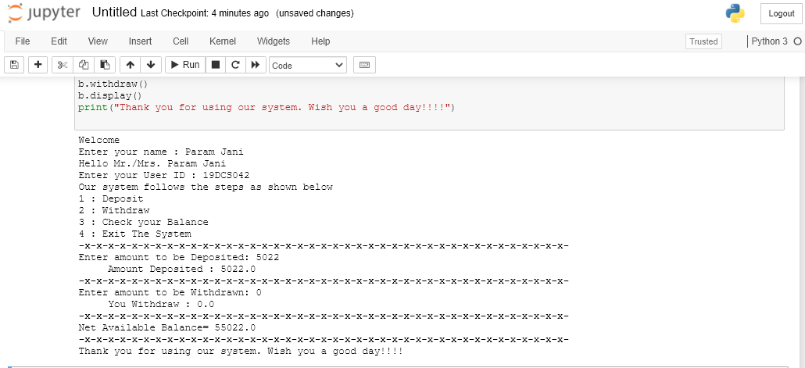
output of deposit & balance check

Slide 9
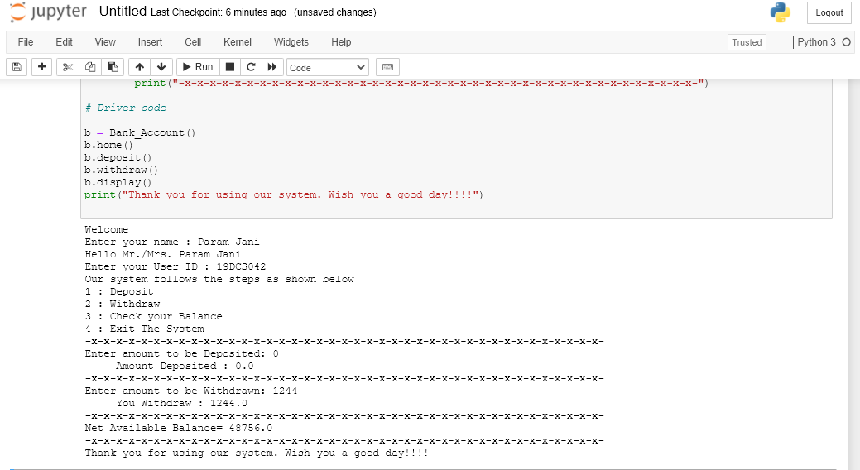
output of withdrawal & balance check

Slide 10
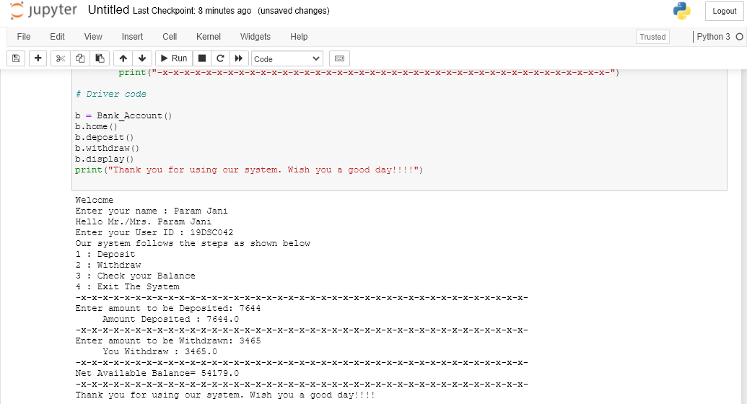
Output of withdrawal along with deposit

Slide 11
References
https://www.w3schools.com/python/
https://www.programiz.com/python-programming/function
https://www.onlinegdb.com/online_python_compiler

Slide 12
Thank you !

